Slide 1
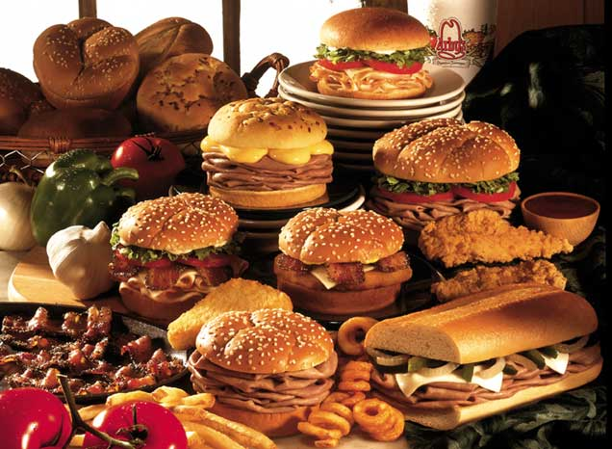


Slide 2

Where can I find free food on campus?
Tons of organizations and clubs on campus host events that offer free food
But by the time you find out about these:
The food is all gone, or
The event has ended

Slide 3


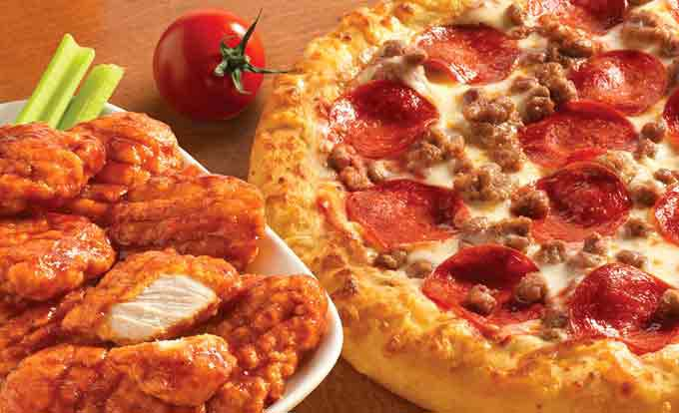
Our solution to this is
A web/mobile app that provides REAL-TIME updates on events with free food around campus​
What events?
Where?
When? (start and end time)
What food?

Slide 4
I'm hungry. Tell me more details!
With FEASTA, you can:
Browse on-going and upcoming events with free food up to 11:59pm everyday.
Search your favorite foods or dietary restrictions
Save your preferences to your profile:
To curate your feeds, or
(optional) daily push notification about free food availability

Slide 5
My event has free food, so…
→ Sign up as a promoter!!!
As a promoter on FEASTA, you can:
Upload an image of your food
Tag the post with your event’s location and time
Smart-tag the categories of your food

Slide 6
Other features
As a diner, you can also:
Leave ratings and reviews
Receive notification when food has run out
As a promoter, you can also:
See analytics of your events, e.g.
What foods attract most attendees
What time blocks have the highest turnouts
From which buildings your attendees learn about your event

Slide 7
Developer specs
Two client-facing interfaces: diners and promoters
Uber (riders – drivers), EventBrite (attendees – organizers)
Post expiry:
Past events hidden from diners
Event inventory everyday at midnight
.edu verification:
only SJU students can access these data
Concept competitor: Lunchbox

Slide 8
Any questions?

